Slide 1
Solving recursive functions by forming recurrence relation

Slide 2
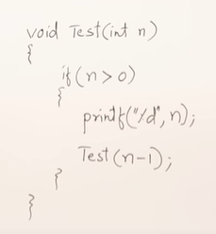
Decreasing function example 1

Slide 3
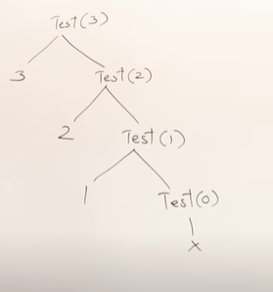

Slide 4
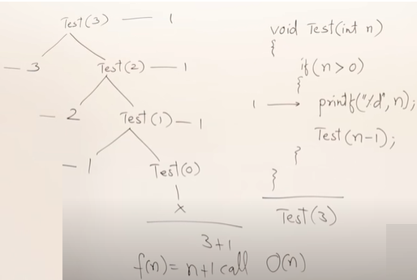

Slide 5
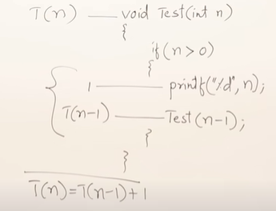

The recurrence Relation is

Slide 6
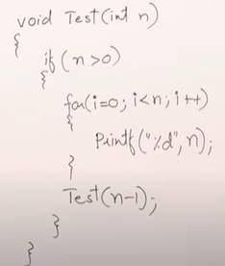
Decreasing function Example 2

Slide 7
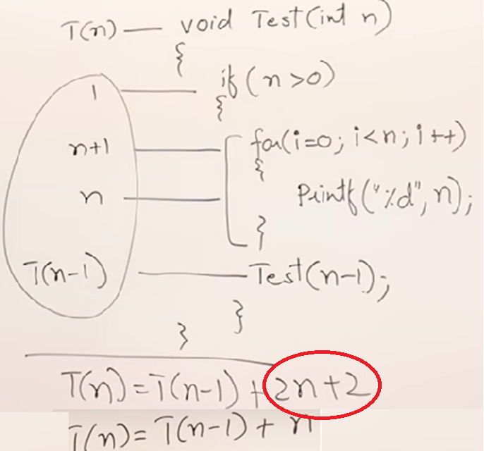

Slide 8
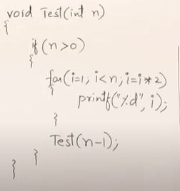

Slide 9
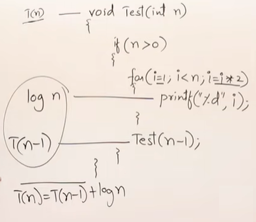
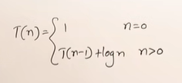

Slide 10
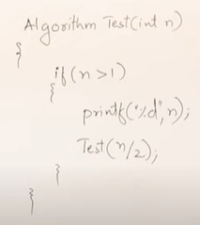
Dividing function example 1

Slide 11
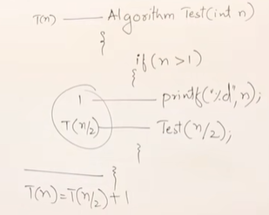


Slide 12
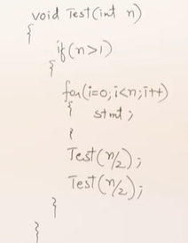
Dividing function example 2

Slide 13
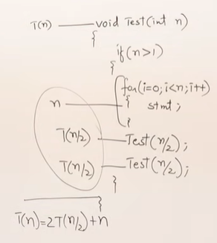

Slide 14

Solving Recurrence Relation
The following are the methods by which we can solve the recurrence relation
Backward Substitution Method
Recursion Tree
Masters Theorem

Slide 15
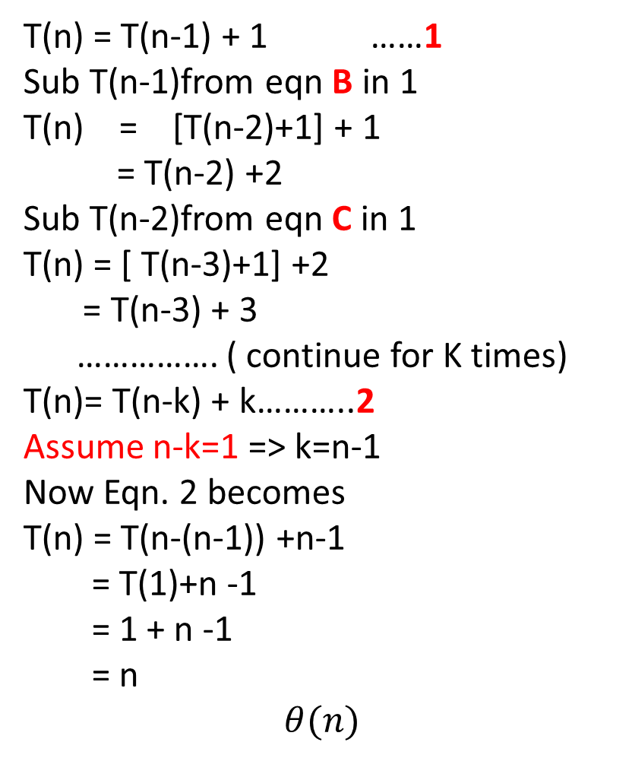
Backward substitution method ex:1
T(n) = T(n-1) + 1 ……1
Sub T(n-1)from eqn B in 1
T(n) = [T(n-2)+1] + 1
= T(n-2) +2
Sub T(n-2)from eqn C in 1
T(n) = [ T(n-3)+1] +2
= T(n-3) + 3
……………. ( continue for K times)
T(n)= T(n-k) + k………..2
Assume n-k=1 => k=n-1
Now Eqn. 2 becomes
T(n) = T(n-(n-1)) +n-1
= T(1)+n -1
= 1 + n -1
= n
$$θ(n)$$
T(n)=T(n-1) +1 …………….A
T(n-1) = T((n-1)-1)+1 =T(n-2)+1 ……B
T(n-2)= T(n-3) +1 ……………..C
T(n-k) = T(n-(k+1)) +1 …………. D

Slide 16

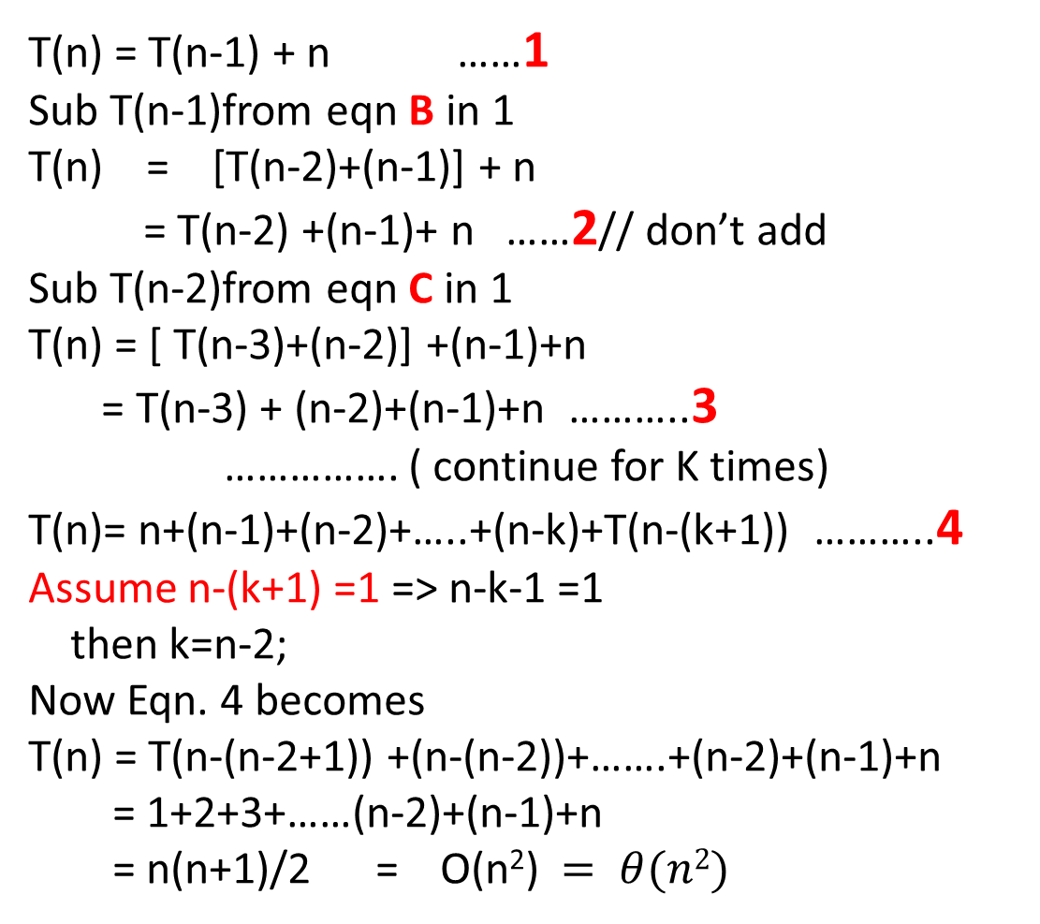
Backward substitution method ex:2
T(n) = T(n-1) + n ……1
Sub T(n-1)from eqn B in 1
T(n) = [T(n-2)+(n-1)] + n
= T(n-2) +(n-1)+ n ……2// don’t add
Sub T(n-2)from eqn C in 1
T(n) = [ T(n-3)+(n-2)] +(n-1)+n
= T(n-3) + (n-2)+(n-1)+n ………..3
……………. ( continue for K times)
T(n)= n+(n-1)+(n-2)+…..+(n-k)+T(n-(k+1)) ………..4
Assume n-(k+1) =1 => n-k-1 =1
then k=n-2;
Now Eqn. 4 becomes
T(n) = T(n-(n-2+1)) +(n-(n-2))+…….+(n-2)+(n-1)+n
= 1+2+3+……(n-2)+(n-1)+n
= n(n+1)/2 = O(n²) $= θ(n2)$
T(n)=T(n-1) +n …………….A ( given )
T(n-1) = T((n-1)-1)+n-1 =T(n-2)+(n-1) ……B
T(n-2)= T(n-3) +(n-2)……………..C
T(n-k) = T(n-(k+1))+ (n-k) ………… D

Slide 17
Backward substitution method:3
T(n) = T(n-1) + logn ……1
Sub T(n-1)from eqn B in 1
T(n) = [T(n-2)+log(n-1)] + logn
= T(n-2) +log(n-1)+ logn ……2// don’t add
Sub T(n-2)from eqn C in 1
T(n) = [ T(n-3)+log(n-2)] +log(n-1)+logn
= T(n-3) + log(n-2) + log(n-1) + logn ………..3
……………. ( continue for K times)
T(n)= T(n-k) + (log(n-(k-1))+(log(n-k-2))+…..+log(n-1) +logn………..4
Therefore T(n-k) = T(n-(k+1))+log(n-k) …………. Using D
Assume that n-(k+1)=1 => n-k-1=1 => k=n-2 ……………5
Now Eqn. 4 becomes
T(n) = T(n-(n-2+1)) +log(n-(n-2))+…….+log(n-2)+log(n-1)+logn
=log1+log2+log3+……+log(n-2)+log(n-1)+log n
= log(1*2*3*4*………*n)
= log n! = logn^{n}
O(nlog n)
T(n)=T(n-1) +logn …………….A
T(n-1) = T((n-1)-1)+log(n-1) =T(n-2)+log(n-1 )……B
T(n-2)= T(n-3) +log(n-2)……………..C
……….
T(n-k)= T(n-(k+1)) + log(n-k) ………….D

Slide 18
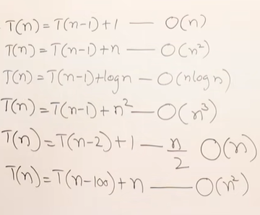
For decreasing function, we observe that

Slide 19
Backward substitution method ex:4
T(n) = T(n/2)+1 ---------= 1
T(n) = [T(n/2²)+1] +1
=T(n/2²)+2 ------------2
T(n) = T(n/2³)+3 ---------3
…..
T(n)= T(n/2^{k})+k
Assume that n/2^{k} =1 => n= 2^{k}
K=log₂n
T(n) = T(1)+log n
= 1 + log n
O(log n)

Slide 20

Backward substitution method:5
T(n) = T(n/2)+n ---------= 1
T(n) = [T(n/2²)+n/2] +n = T(n/2²)+n/2+n -----------2
T(n) = T(n/2³)+n/2² +n/2+n ---------3
…..
T(n)= T(n/2^{k})+n/2^{k-1}+…. n/2² +n/2+n------4
Assume that n/2^{k} =1 => n= 2^{k}
K=log₂n
T(n) = T(1)+n[1/2^{k-1}+1/2^{k-2} +…….1/2 +1]
= 1 + n[1+1] = 1+2n = O(n)

Slide 21

Exercise – H/w

Slide 22
Solving recurrence relation using recursive trees Method

Slide 23
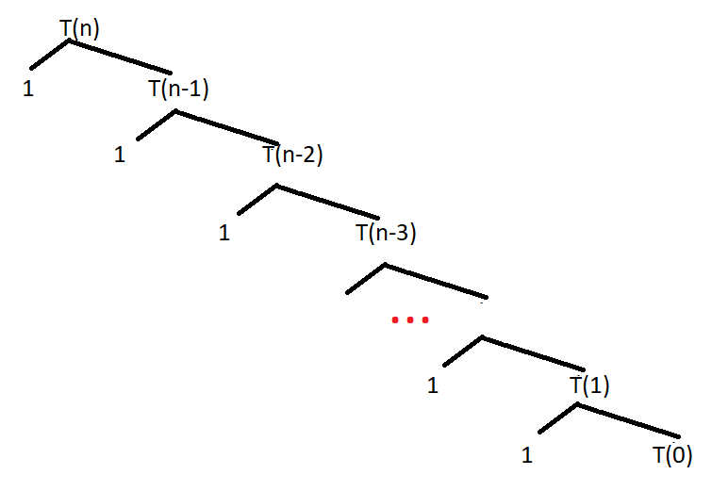
Solve the given recurrence relation using recursive trees
The time taken for this alg is
=1.1.1.1 …….. ( n times)
=n
O(n)

Slide 24
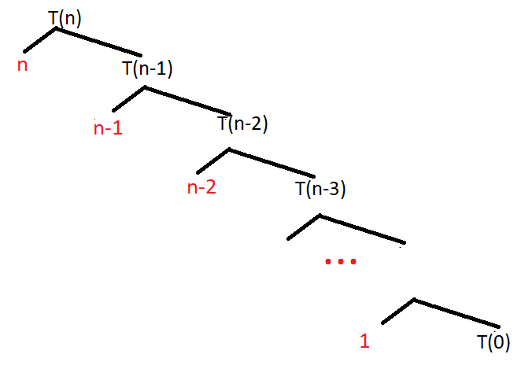
Solve the given recurrence relation using recursive trees
The time taken for this alg is
=n+(n-1)+(n-2)+…..+ 1
=n(n+1)/2
=O(n²)

Slide 25
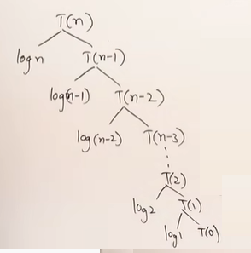
Solve the given recurrence relation using recursive trees
The time taken for this alg is
=logn + log(n-1)+log(n-2)+…….+ log2+ log 1
=log(n*(n-1)*(n-2)*……2 *1))
=log(n!)
=O(logn^{n})
=O(nlogn)

Slide 26
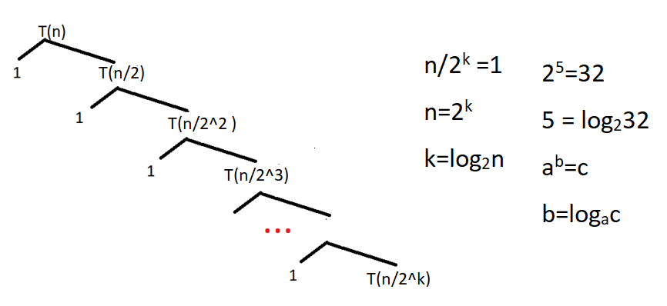
Solve the given recurrence relation using recursive trees
The time taken for this alg is
O(logn)

Slide 27
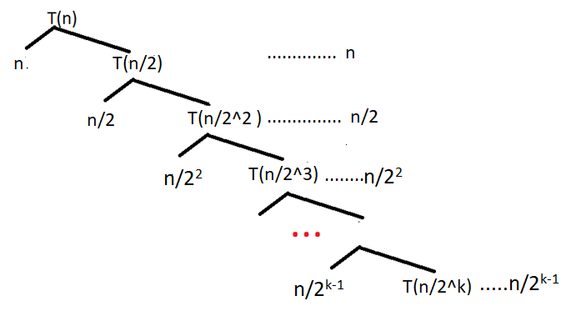
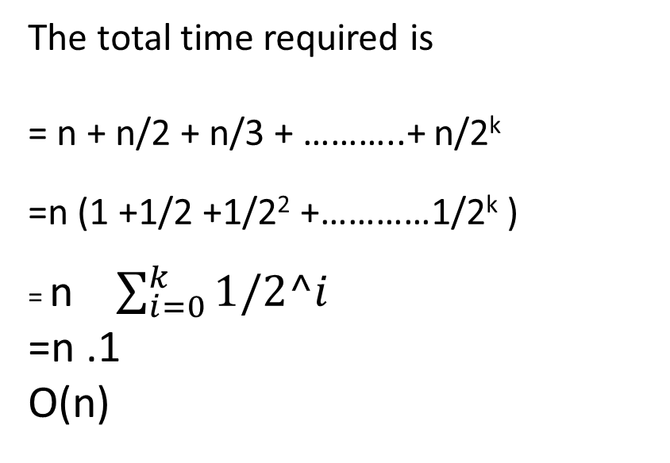
Solve the given recurrence relation using recursive trees
The total time required is
= n + n/2 + n/3 + ………..+ n/2^{k}
=n (1 +1/2 +1/2² +…………1/2^{k} )
= n $\sum_{i=0}^{k}{1/2^i}$
=n .1
O(n)

Slide 28
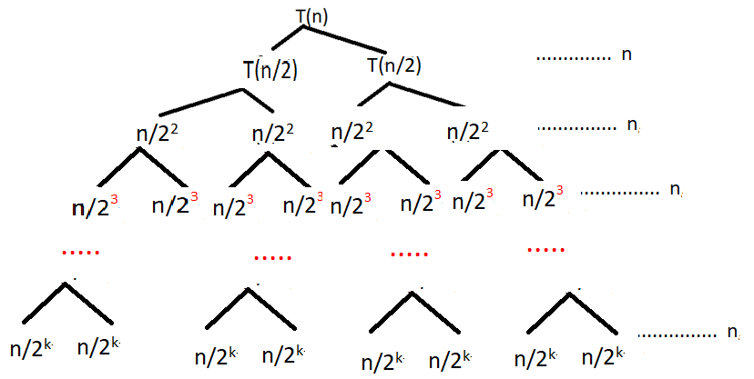
Solve the given recurrence relation using recursive trees - Homework

Slide 29
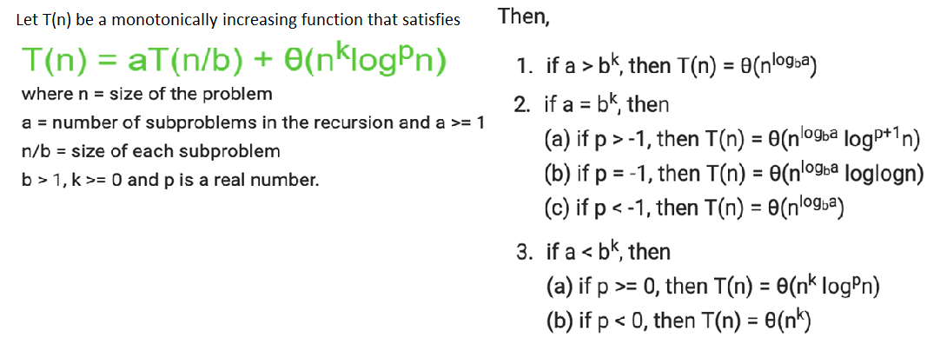
Masters Theorem

Slide 30
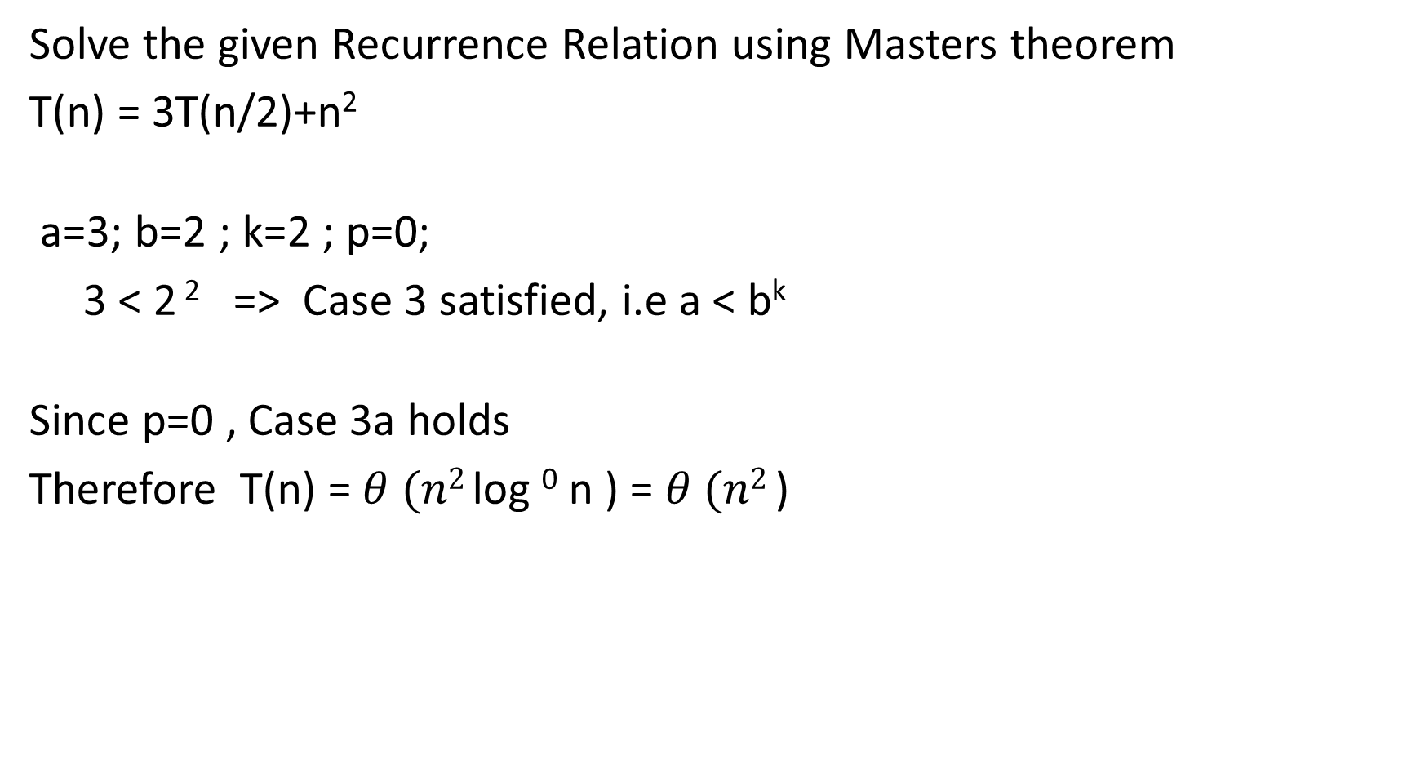
Solve the given Recurrence Relation using Masters theorem
T(n) = 3T(n/2)+n²
a=3; b=2 ; k=2 ; p=0;
3 < 2 ² => Case 3 satisfied, i.e a < b^{k}
Since p=0 , Case 3a holds
Therefore T(n) = $θ (n2$log ⁰ n ) = $θ (n2$)

Slide 31
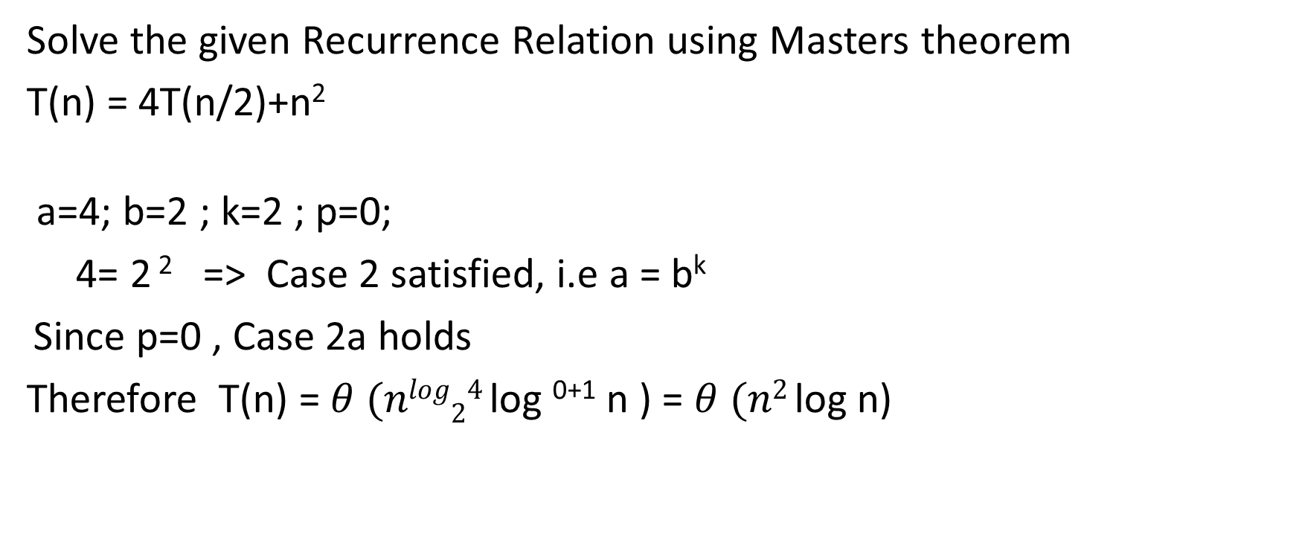
Solve the given Recurrence Relation using Masters theorem
T(n) = 4T(n/2)+n²
a=4; b=2 ; k=2 ; p=0;
4= 2 ² => Case 2 satisfied, i.e a = b^{k}
Since p=0 , Case 2a holds
Therefore T(n) = $θ (nlog24$log ⁰⁺¹ n ) = $θ (n2$log n)

Slide 32
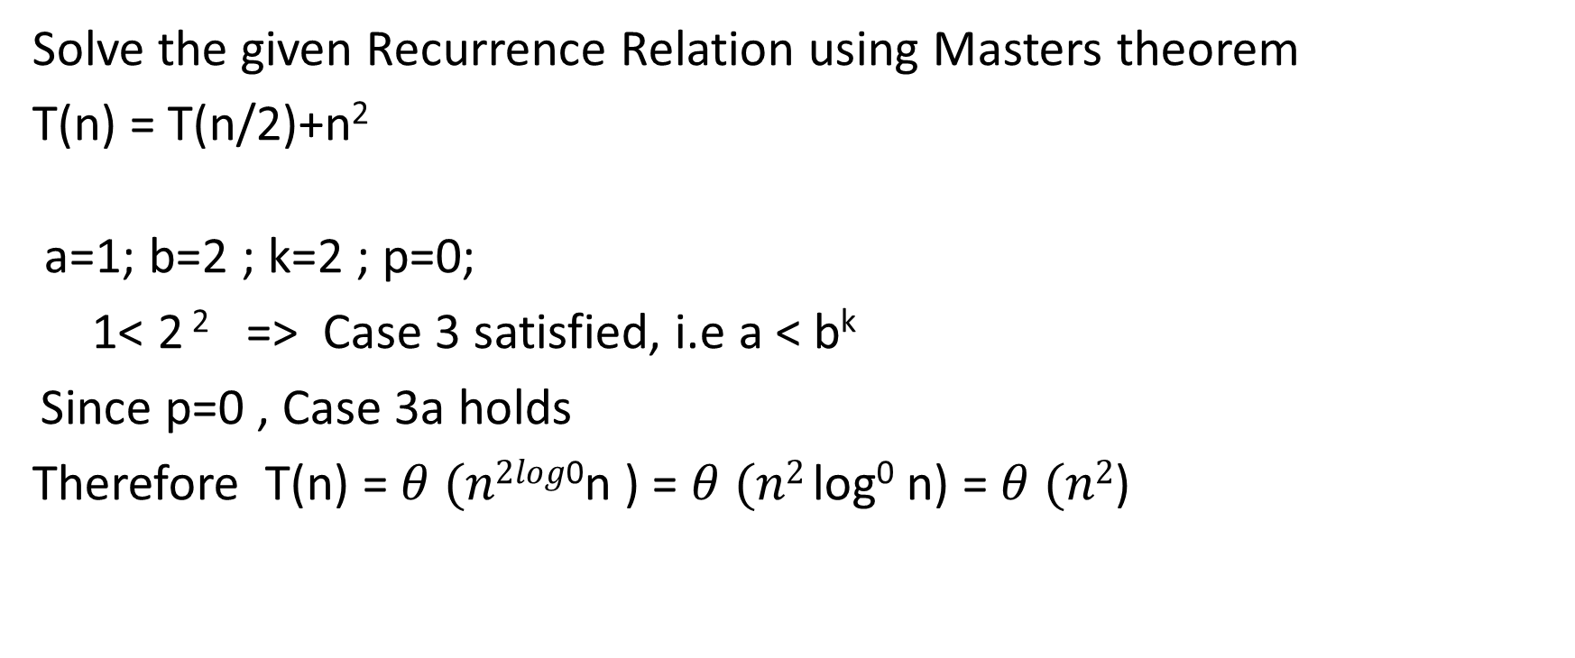
Solve the given Recurrence Relation using Masters theorem
T(n) = T(n/2)+n²
a=1; b=2 ; k=2 ; p=0;
1< 2 ² => Case 3 satisfied, i.e a < b^{k}
Since p=0 , Case 3a holds
Therefore T(n) = $θ (n2log$⁰n ) = $θ (n2$log⁰ n) = $θ (n2$)

